Slide 1
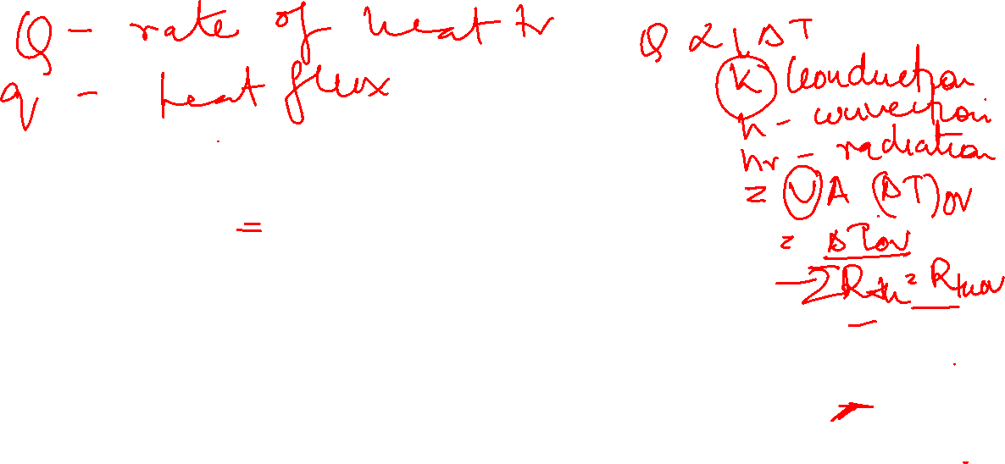
Process Heat Transfer
Conduction and Radiation
Class 5

Slide 2
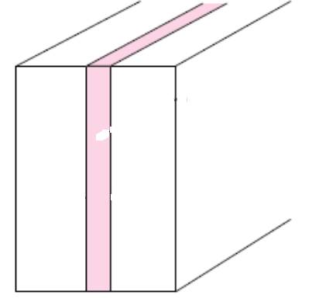
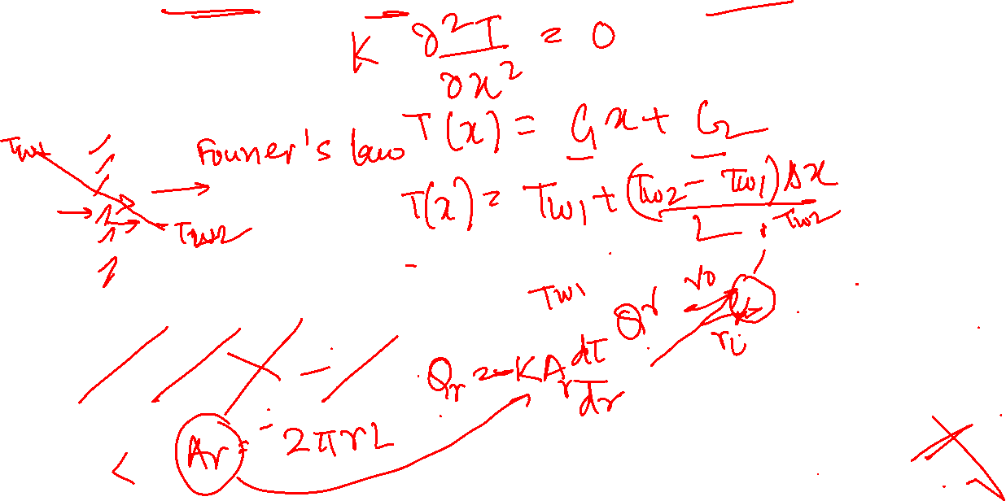
One dimensional steady state heat conduction with no heat generation
Cartesian coordinates
Radial System (Cylindrical)
T =T(x)
Qx

Slide 3

Radial System (Cylindrical)
One dimensional heat flow through hollow cylinder
T =T(r)
Logarithmic temperature distribution

Slide 4
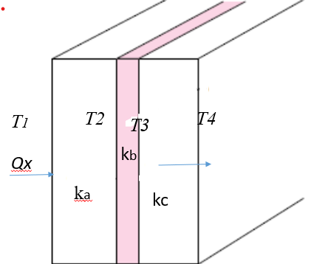
One dimensional heat flow through multiple layers
Radial System (Cylindrical)
T =T(r)

Slide 5
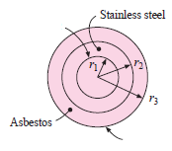
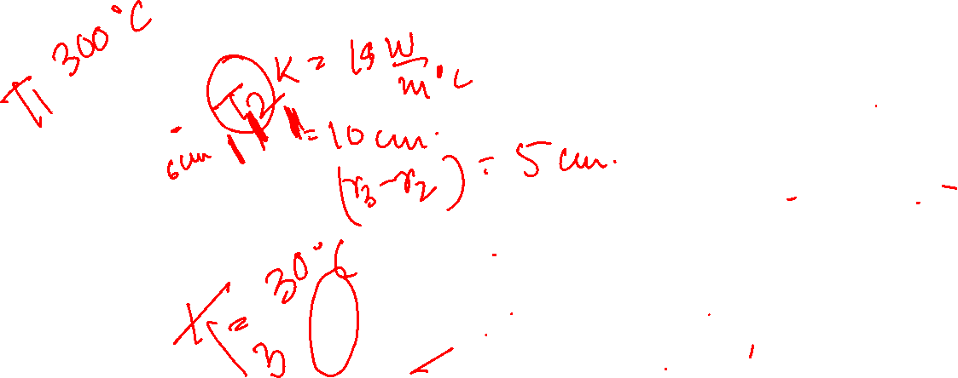
Example Problem:
A stainless steel tube [k= 19 W/m(C)] of 6 cm ID and 10 cm OD is covered with a 5 cm layer of asbestos insulation [k= 0.2 W/m(C)]. If the inside wall temperature is 300⁰C and outside temperature is 30⁰C, calculate (a) heat loss per meter of tube length (b) temperature at tube- insulation interface.

Slide 6
Process Heat Transfer
Conduction and Radiation
Class 6

Slide 7
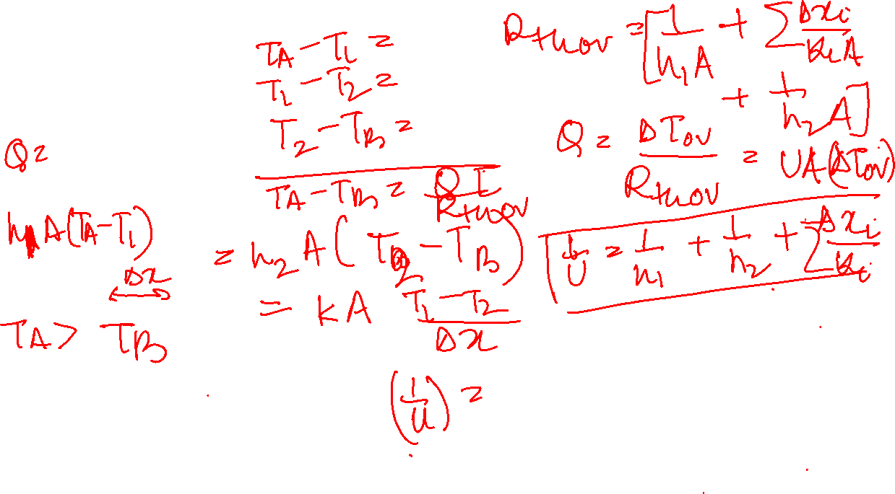
Convection Boundary Condition
k
Q
Overall heat transfer through a plane wall

Slide 8
Hollow Cylinder
TB
T0
TA
Ti
Electrical Resistance Analogy

Slide 9
Example Problem:
Water at 80⁰C flows through a tube of 2.5 cm inside diameter and 5 mm wall thickness such that
hi = 3500 W/m²(⁰C). The tube loses heat to the ambient by free convection [h0 = 7.6 W/m²(⁰C)].
The ambient temperature is 30⁰C and the thermal conductivity of the tube material is 16 W/m(⁰C).
Estimate the overall heat transfer coefficient and heat loss per unit tube length.

Slide 10
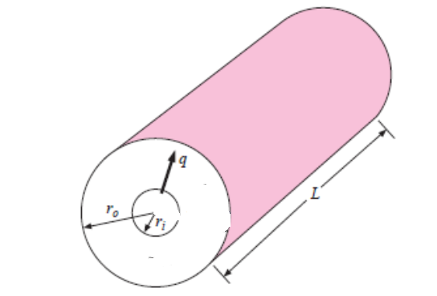
Critical Radius of Insulation
ho, Tamb
To
Ti

Slide 11
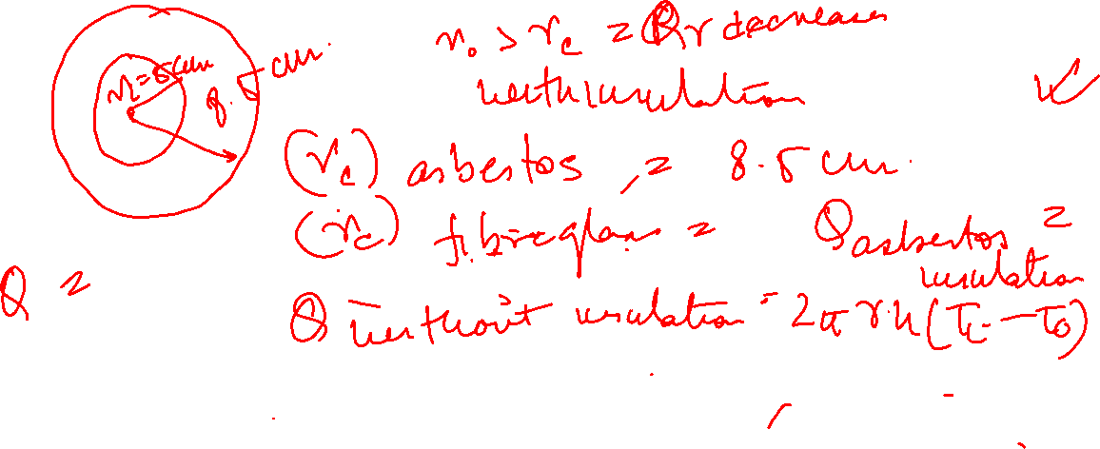
Example Problem:
A 5.0 cm diameter pipe carrying hot liquid at 200⁰C is to be insulated to reduce the heat loss to the ambient (h=2W/m²C) at 30⁰C. Two insulating materials namely asbestos [k= 0.17W/m(⁰C)] and fiberglass [k=0.04W/m(⁰C)] are available. Which one would you prefer to select for the particular insulation purpose? Asbestos is a cheaper material than fiberglass.

Slide 12
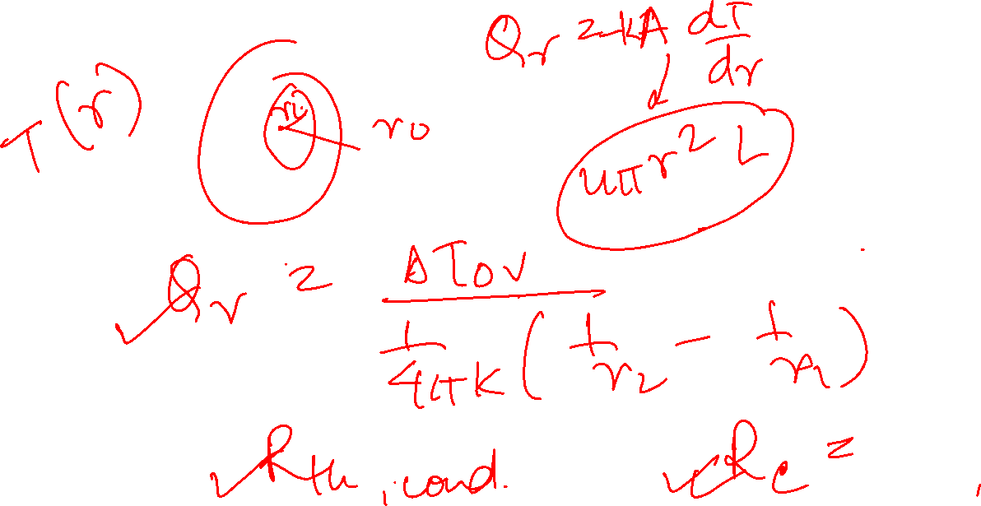
Hollow Sphere

